Slide 1
International Women's Day
Mateusz Tybel kl. 7 B

Slide 2
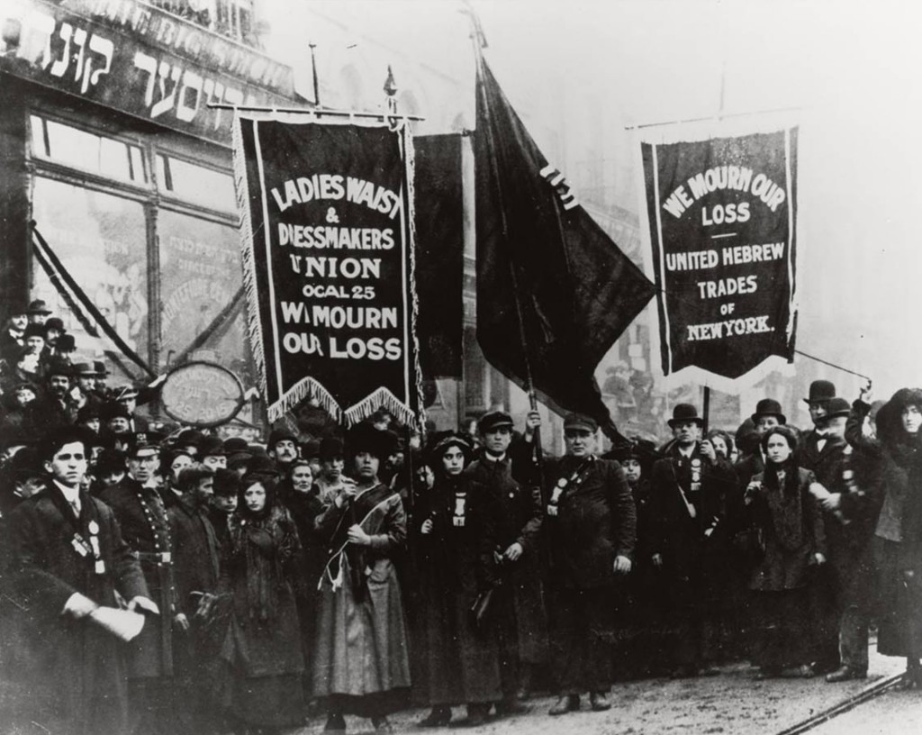
The earliest celebration of Women's Day was held on February 28, 1909 in New York. Initially, it was claimed that the day commemorates the protest of women working in the production of clothes in Nowe. In 1910, at the International Conference of Socialist Women in Copenhagen, on the initiative of Clara Zetkin, it was decided to organize International Women's Day.

Slide 3
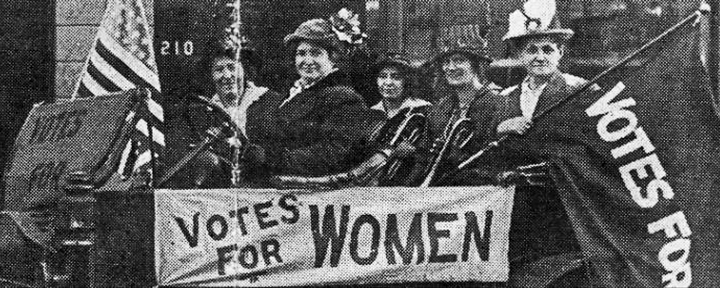
The first truly world celebration took place the following year. On March 19, 1911, over a million people in Germany, Austria, Denmark and Switzerland took to the streets to stand up for women's rights to vote and to hold public office.

Slide 4
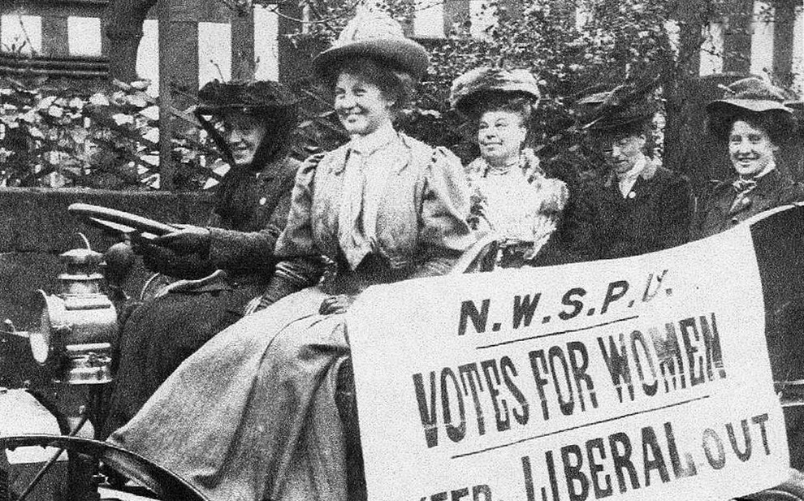
In the following years, some countries celebrated Women's Day on March 8. On that day, in 1917, women working in the textile industry took to the streets in St. Petersburg, thus starting the February Revolution, which soon led to the collapse of tsarism. After the Bolsheviks came to power, on March 8 it became an official holiday in the Soviet Union, although it was not established as a day off from work until 1965.

Slide 5
In 1945, the United Nations Charter was signed, which was the first international document confirming the principle of equality between women and men. 1975 was declared the International Women's Year by the United Nations. In 1977, the United Nations declared March 8 as a day of women's rights and world peace.

Slide 6
In which countries is it an official holiday? Women's Day is an official holiday in Afghanistan, Angola, Armenia, Azerbaijan, Belarus, Burkina Faso, Eritrea, Georgia, Guinea-Bissau, Cambodia, Kazakhstan, Cuba, Laos, Moldova, Mongolia, Nepal, Tajikistan, Turkmenistan, Ukraine, Uzbekistan, Vietnam and Zambia.

Slide 7
In China and Madagascar, March 8 is a women's-only day off. In Romania and Bulgaria, Women's Day is celebrated together with Mother's Day. In Italy, on March 8, it is customary to give mimosa sprigs.

Slide 8
In West Africa, Women's Day is an important holiday for pro-female non-governmental organizations, which organize various types of picnics, rallies, conferences and charity events on this occasion. In Cameroon, Women's Day runs all week, and government officials wear special costumes with the Women's Day logo.

Slide 9
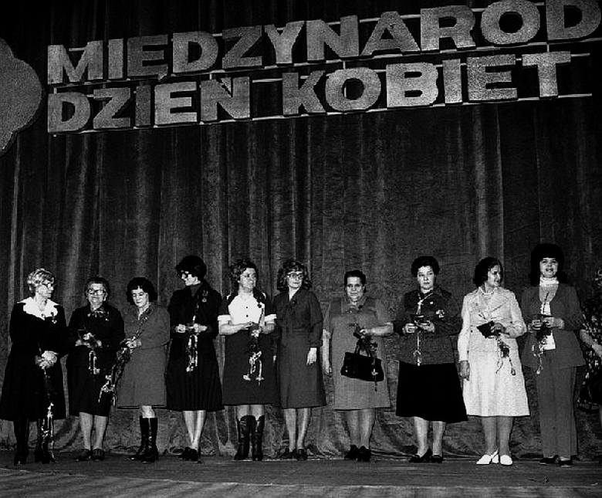
Women's Day in Poland In Poland, they were organized for the first time on March 24, 1924 by the Central Women's Department of the PPS. In Poland, the holiday was popular during the Polish People's Republic.

Slide 10
In the 1970s, flowers (cloves and later tulips) joined the popular gifts (tights, towel, cloth, soap, coffee). In 1993, Women's Day ceased to be a public holiday in Poland.

Slide 11
Życzenia na Dzień Kobiet
Dla Pań, które znam, ładnych życzeń parę mam. Zdrowia, szczęścia i miłości, bukiet kwiatów i słodkości! Niech się niesie w cały kraj Dziś dla Pań wszystkiego naj!

Slide 12
https://wiadomosci.onet.pl/kraj/dzis-dzien-kobiet-skad-wzielo-sie-swieto-8-marca-i-gdzie-jest-obchodzone/5hnn7bf
https://pl.wikipedia.org/wiki/Dzie%C5%84_Kobiet
https://www.naszeszlaki.pl/archives/35446
https://www.pap.pl/aktualnosci/news%2C481908%2Cwlochy-zwyczaj-wreczania-paniom-mimoz-w-dniu-kobiet-ma-juz-70-lat.html
https://hiro.pl/8-porad-dla-kobiet-ktore-mysla-o-slubie-od-sufrazystki-z-1918-roku/
https://www.ekokalendarz.pl/dzien-kobiet/sufrazystki/
https://historia.wprost.pl/10304159/dzien-kobiet-obchodzimy-juz-110-lat-na-poczatku-swieto-bylo-zwiazane-z-walka-o-emancypacje.html
https://zielonyogrodek.pl/abc-ogrodnika/aktualnosci-z-branzy/464-skad-pochodza-kwiaty-na-dzien-kobiet
https://www.tcz.pl/index.php?p=1,65,0,archiwum-wydarzen&item=86156a6342553ceb&title=
https://dziennikbaltycki.pl/zyczenia-na-dzien-kobiet-2021-najpiekniejsze-zyczenia-wierszyki-dla-kobiet-na-kartke-i-sms-krotkie-rymowanki-dla-kobiet-na-8/ar/c6-12971934

