Slide 1
SLOWING DOWN- A New Face of European Education
Michał Piórkowski
Zespół Szkolno-Przedszkolny im. Czesława Miłosza w Siemianicach

Slide 2
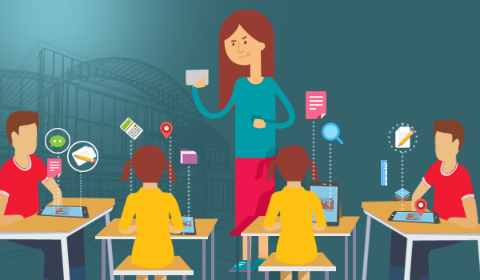
How to improve communication between teachers and students?
Michał Piórkowski
Zespół Szkolno-Przedszkolny im. Czesława Miłosza w Siemianicach

Slide 3
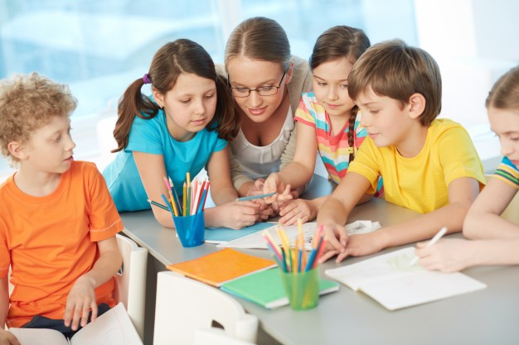
Create a Supportive Environment
During classes, make sure that students feel comfortable to ask questions and ensure they know it’s a safe space where they won’t be ridiculed. Another great way is encouraging group projects where students work together rather than compete for grades and recognition. You will find this approach fosters teamwork, cooperation and open dialogue between students and teachers.
Michał Piórkowski
Zespół Szkolno-Przedszkolny im. Czesława Miłosza w Siemianicach

Slide 4
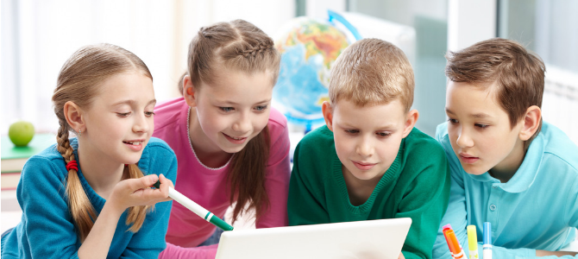
Challenge Students with Interesting Work
Nothing will break down communication more than an uninspired and bored student. Naturally, their enthusiasm levels will increase exponentially if they are excited by the topic or task and it challenges them.
Michał Piórkowski
Zespół Szkolno-Przedszkolny im. Czesława Miłosza w Siemianicach

Slide 5
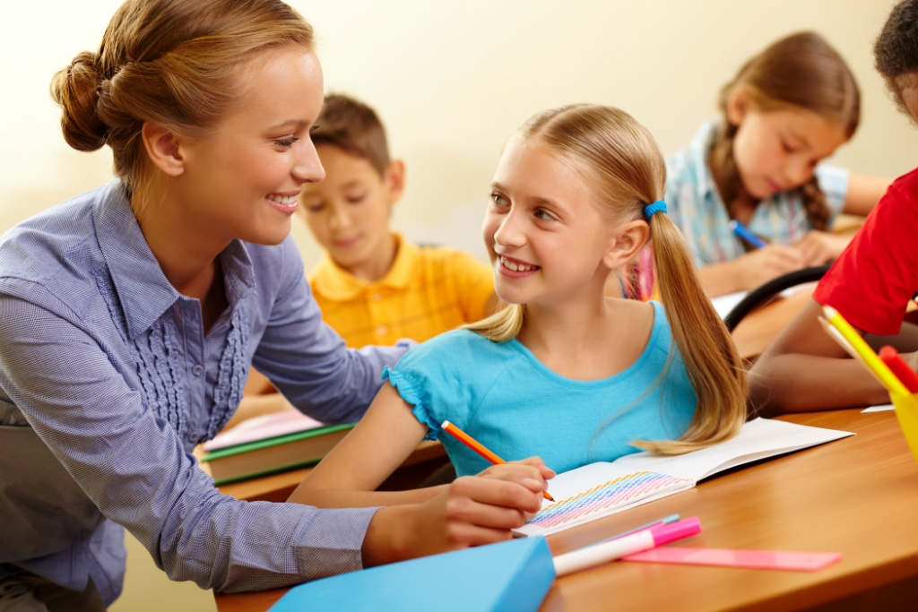
Be an Active Listener
Listening has always been the most important aspect of communication, yet we tend to forget it so easily. Try to apply the student-centered learning approach and try to drift away from frontal teaching. Include your students into group research, interpretation, discussions. Motivate your students to listen to their classmates. Most of all, don’t forget to listen to your students yourself. They will tell you what they understand and what should be your next step – both verbally and non-verbally.
Michał Piórkowski
Zespół Szkolno-Przedszkolny im. Czesława Miłosza w Siemianicach

Slide 6
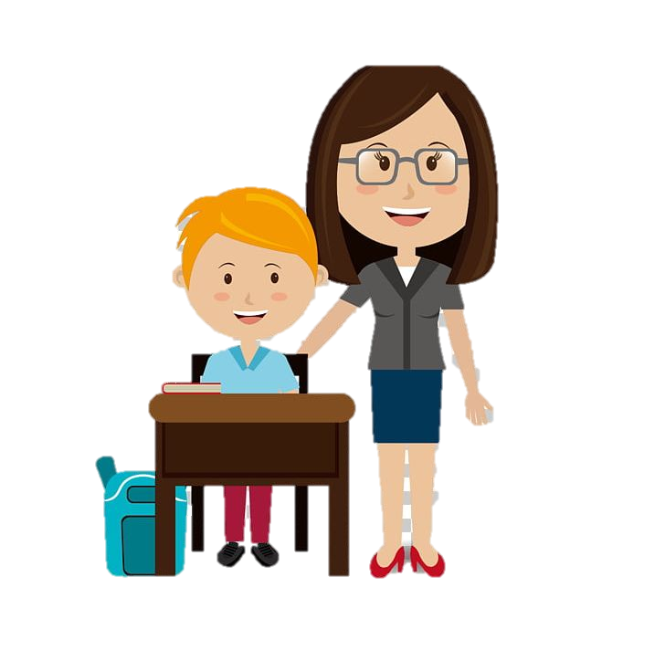
Find Teachable Moments
Whatever the age group you are working with, maximize on the everyday happenings in the classroom environment. For example, if a student answers a question in a complicated way, you might ask that they rephrase what they said, or challenge the class to ask clarifying questions. If an unfamiliar word pops up in a text or on a film, pause in order for the class to search for the word in the dictionary.
Michał Piórkowski
Zespół Szkolno-Przedszkolny im. Czesława Miłosza w Siemianicach

Slide 7
Practice Positive Reinforcement
Focusing on small or large achievements can really help to build students confidence and encourage them to keep trying. Maybe they came top of the class in a test or helped another student in some way, whatever it may be, your commending their efforts will not go unnoticed. It will strengthen your rapport and develop a mutual appreciation.
Michał Piórkowski
Zespół Szkolno-Przedszkolny im. Czesława Miłosza w Siemianicach

Slide 8
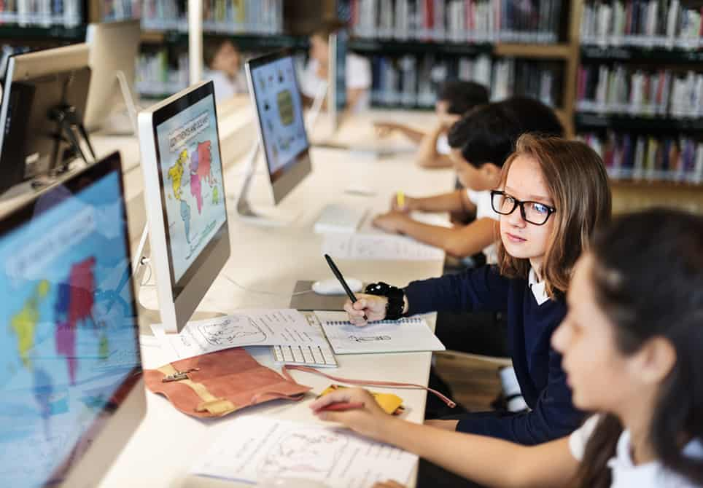
Blended Learning
With blended learning, students can be assigned with learning core concepts through online school apps as homework and later learning how to apply them to solve problems can be done in the classrooms. This makes students self-directed learners, where they are free to use their imaginations on what they have learnt. Students also find it easy learning online since they can refer the resources again and again.
Michał Piórkowski
Zespół Szkolno-Przedszkolny im. Czesława Miłosza w Siemianicach

